Slide 1
An introduction on demonstration learning
Bran 2021.12.15

Slide 2
Context
What is demonstration
Two research directions of demonstration
Sample selection
Sample ordering
Conclusion

Slide 3
Context
What is demonstration
Two research directions of demonstration
Sample selection
Sample ordering
Conclusion

Slide 4
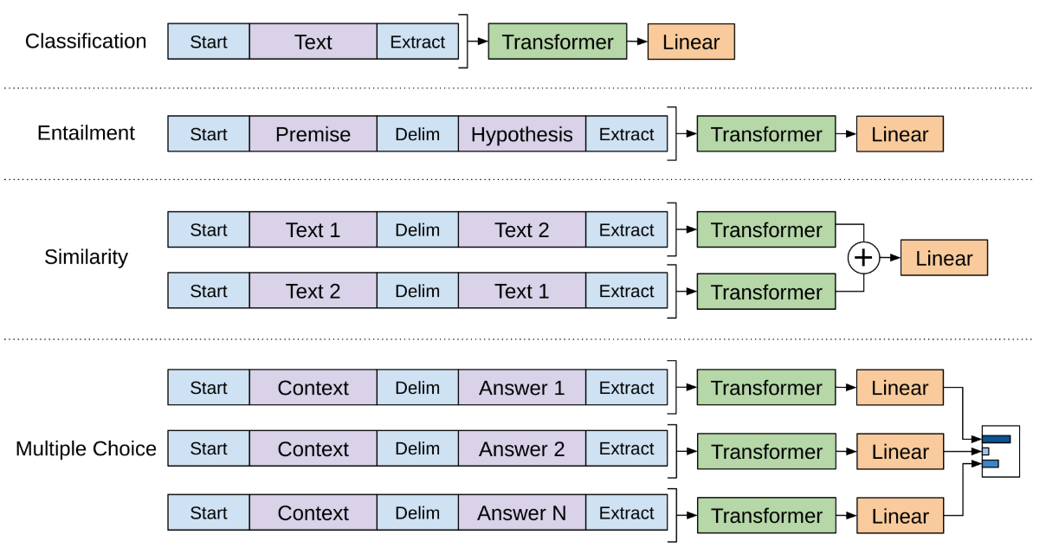


GPT
Pretrained LM
Task-specific head
Disadvantage:
Need a lot of task-specific data to fine tune the model
(thousands or hundreds of thousands)
Transformer-based Pretrained LM + Fine-tuning
Notes:
Start from the first generation gpt model

Slide 5
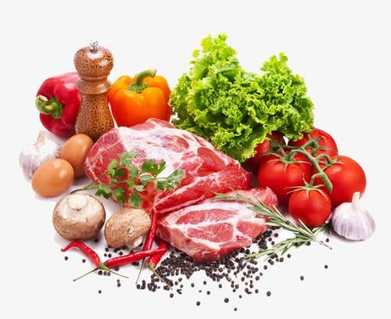

How do humans solve problems?
Let’s take cooking as an example. Suppose:
Your mom ask you to cook
There are a lot of ingredients, such as steaks, eggs and tomatoes
What should I cook? Steak or tomato and egg soup
How to cook it?
Notes:
Start from the first generation gpt model

Slide 6
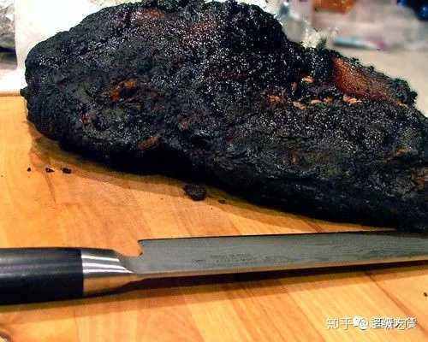
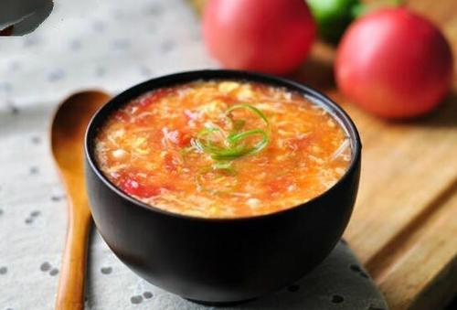
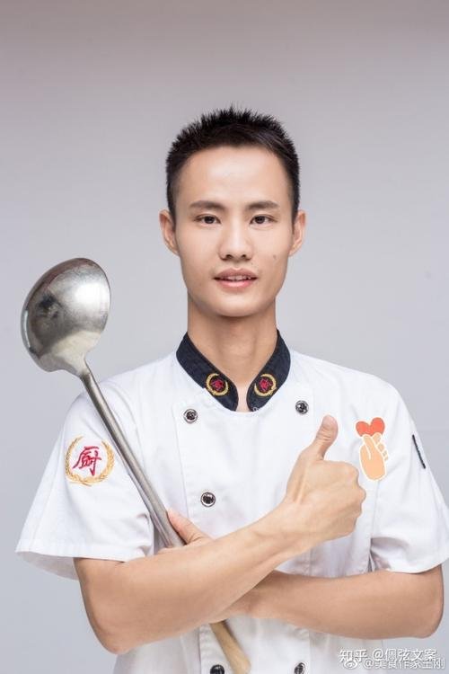

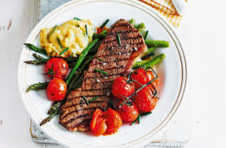
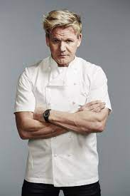
How can your mom help you?
trial and error
Reinforcement learning
Fine-tuning
Prompt
Demonstration
Need a lot of extra ingredients
(reinforcement learning)
Find a tomato and egg soup master to teach you
(fine-tuning)
Give you some cooking videos
(demonstration)
She told you to make a tomato and egg soup (but she didn’t tell you how to cook it)
Find a steak master to teach you
(fine-tuning)
In-context learning
(prompt)
Notes:
Question : which one is demonstration?
These methods can be combined together. Such as …
If you use demonstration and prompt without fine-tuning, it’s called in context learning
In context learning is a kind of prompt based learning ( continues prompt , fine tuning…)
Fine tuning need a lot of extra ingredients while in-context learning don’t
The reason why in context learning woks is you have been pretrained. Which means you have learned cooking before, such as how to cook pork, so even if you … ( before the GPT3 in context learning performances bad)

Slide 7
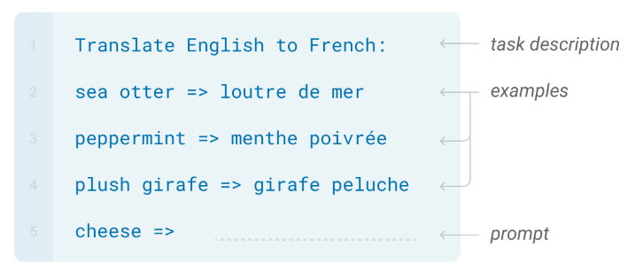
What is demonstration
Notes:
Give the definition
Go back to the last slid
Usually fine tuning is the best method
But gpt3 proves with a large enough pretrained LM in zero shot one shot few shot, in context learning works good

Slide 8
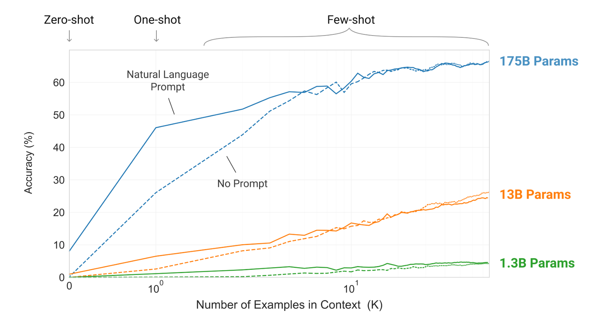
Why it’s important?
Remove extraneous symbols from a word task by GPT3
Notes:
Simple task
Demonstration improves the performance a lot
If you have enough context, prompt is not necessary

Slide 9
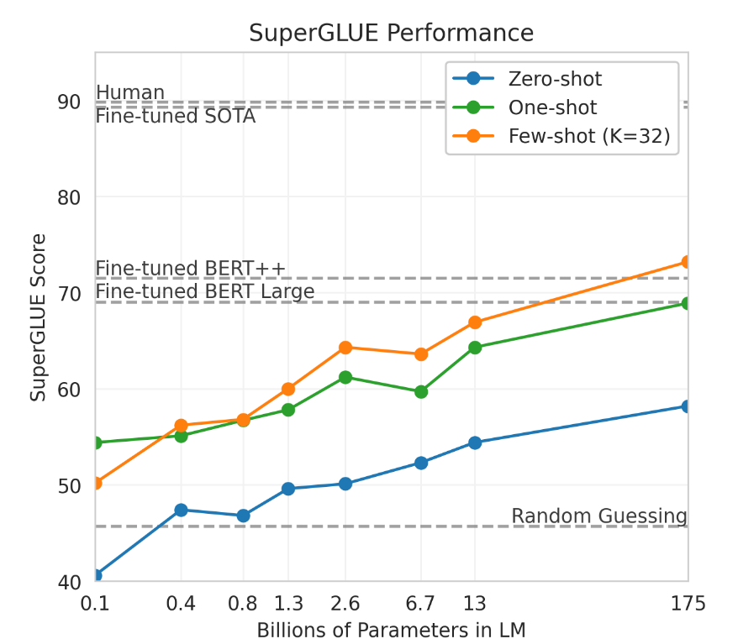
Why it’s important?
Notes:
Demonstration performances good in a smaller model
But in general, we will combine demonstration with prompt and fine-tuning to get better performance since we don’t have gpt3 to use

Slide 10
Context
What is demonstration
Two research directions of demonstration
Sample selection
Sample ordering
Conclusion

Slide 11
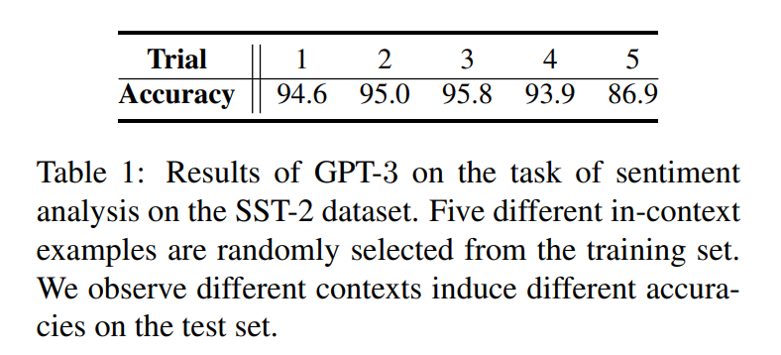
Sample selection
How to choose the most effective examples?
Similarity
Notes:
This question is similar to context retriever task

Slide 12
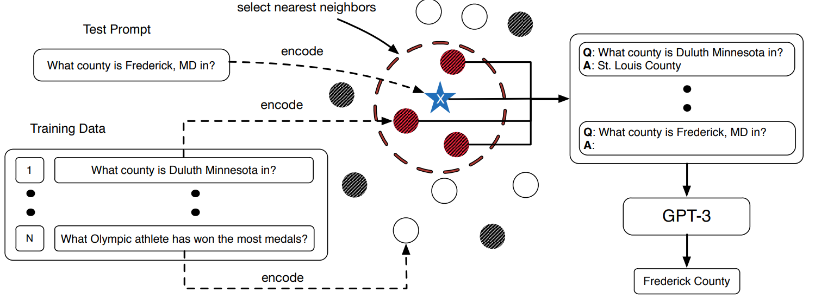



Similarity
KATE : What Makes Good In-Context Examples for GPT-3? Jiachang Liu
RoBERTa
Unused training samples
training samples selected by KATE
training samples selected by
random
Notes:
This question is similar to context retriever task
You can see model only lean the pattern from demonstrations. The demonstrations don’t mention the answer at all. It’s different with context retriever
Go back to cooking steak is M3, in video steak is M8

Slide 13
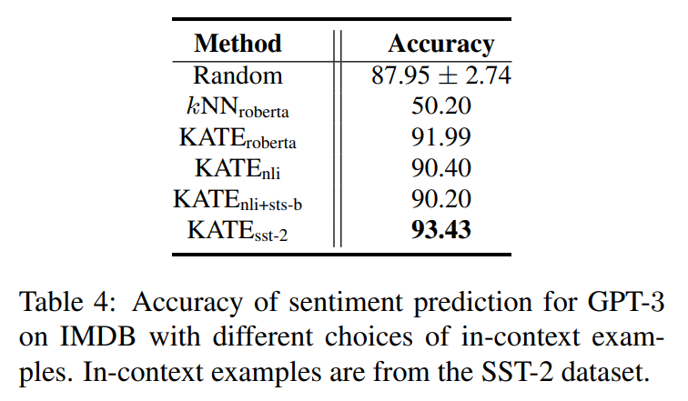
Sentiment analysis
KATE : What Makes Good In-Context Examples for GPT-3? Jiachang Liu
Notes:
This question is similar to context retriever task
You can see model only lean the pattern from demonstrations. The demonstrations don’t mention the answer at all. It’s different with context retriever

Slide 14
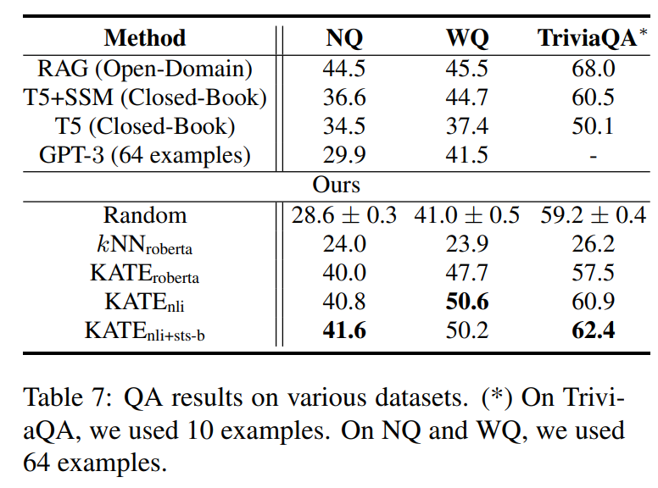
QA
KATE : What Makes Good In-Context Examples for GPT-3? Jiachang Liu
Notes:
Closed book means only input the query without passage
This is to test hove many knowledge is stored in the model
Results shows KATE can dig more knowledge from gpt3 model

Slide 15
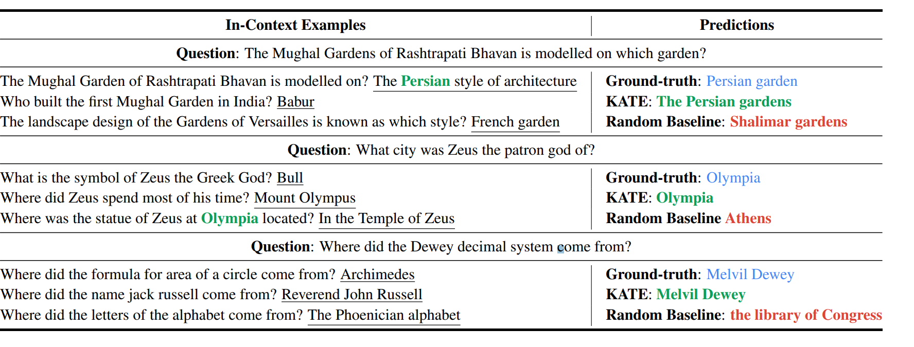
QA
KATE : What Makes Good In-Context Examples for GPT-3? Jiachang Liu

Slide 16
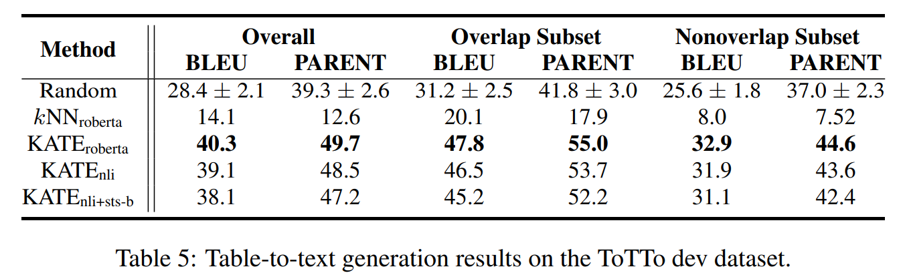
Table to text generation
KATE : What Makes Good In-Context Examples for GPT-3? Jiachang Liu
Notes:
KATE nli is worse than kate roberta, this is because the format in table to text is very different from nli task

Slide 17
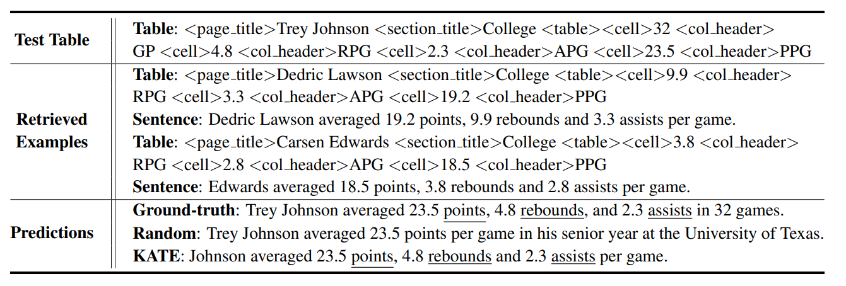
Table to text generation
KATE : What Makes Good In-Context Examples for GPT-3? Jiachang Liu
Notes:
KATE nli is worse than kate roberta, this is because the format in table to text is very different from nli task

Slide 18
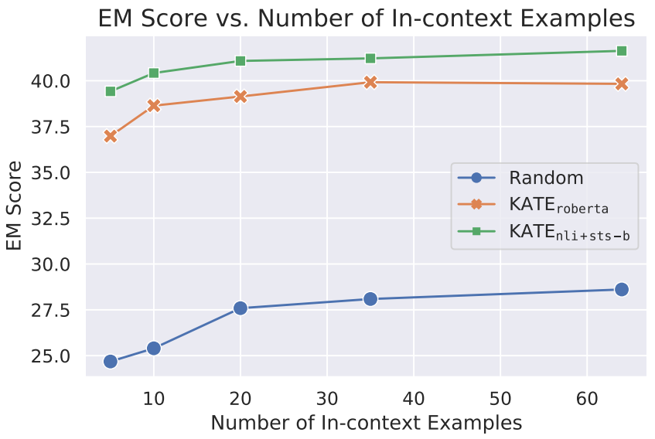
Demonstration number
KATE : What Makes Good In-Context Examples for GPT-3? Jiachang Liu
Notes:
KATE nli is worse than kate roberta, this is because the format in table to text is very different from nli task

Slide 19
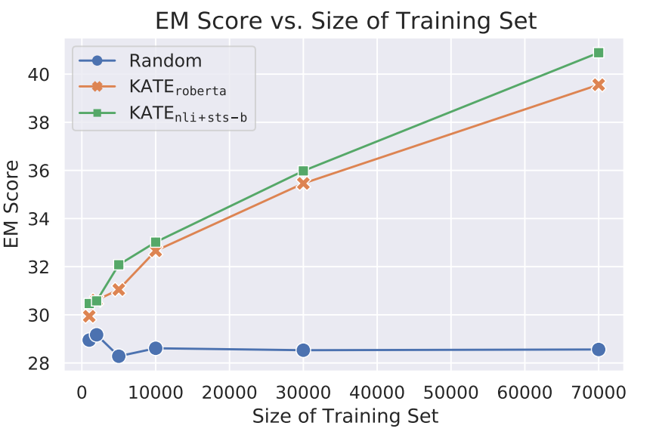
Size of training set
KATE : What Makes Good In-Context Examples for GPT-3? Jiachang Liu
Notes:
KATE nli is worse than kate roberta, this is because the format in table to text is very different from nli task

Slide 20
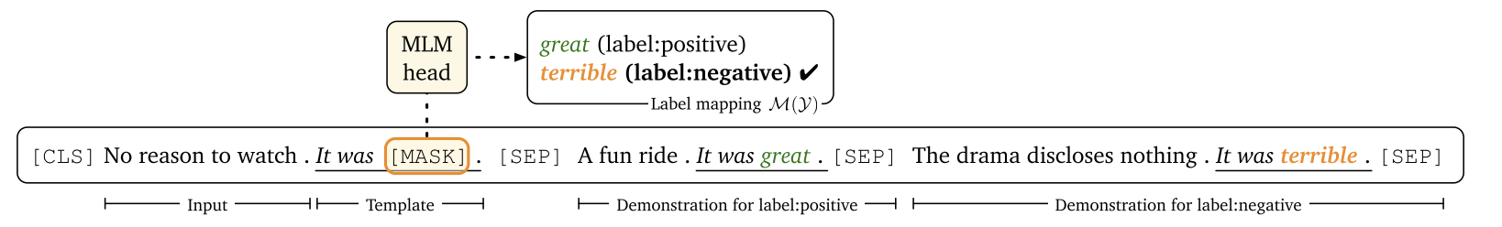
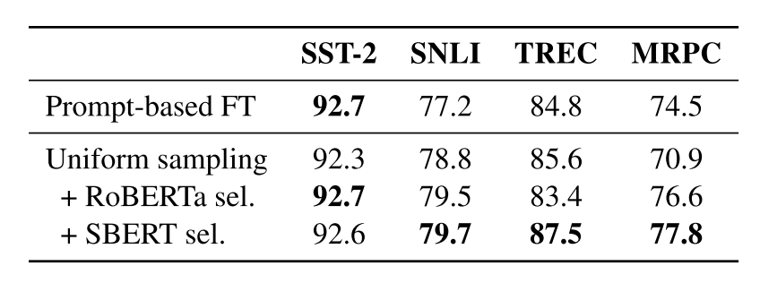
Similarity
Making Pre-trained Language Models Better Few-shot Learners, Tianyu Gao
For each dataset, there are only 16 samples for each class
Notes:
Last work use gpt3 and no fine tuning
This work (shanshan) shows demonstration also works with fine tuning on a smaller model
They using only one demonstration ( go back to gpt3 PAGE)
Sample from top 50% during training. During test, ensemble
16 samples
Demonstration works for both in context alone or in context with fine tuning
Both of them shows fine tuned encoder is better

Slide 21
Sample selection
Conclusion:
Using similarity to choose the demonstration is helpful
Use a fine tuned sentence encoder is better than a un-fine tuned one
This method only works for few shot. If there are a lot of training samples, it’s time consuming to measure the similarity
Notes:
It shows the order influences the performance a lot. Though increase the model size can solve this problem( but it’s impractical)

Slide 22
Context
What is demonstration
Two research directions of demonstration
Sample selection
Sample ordering
Conclusion

Slide 23
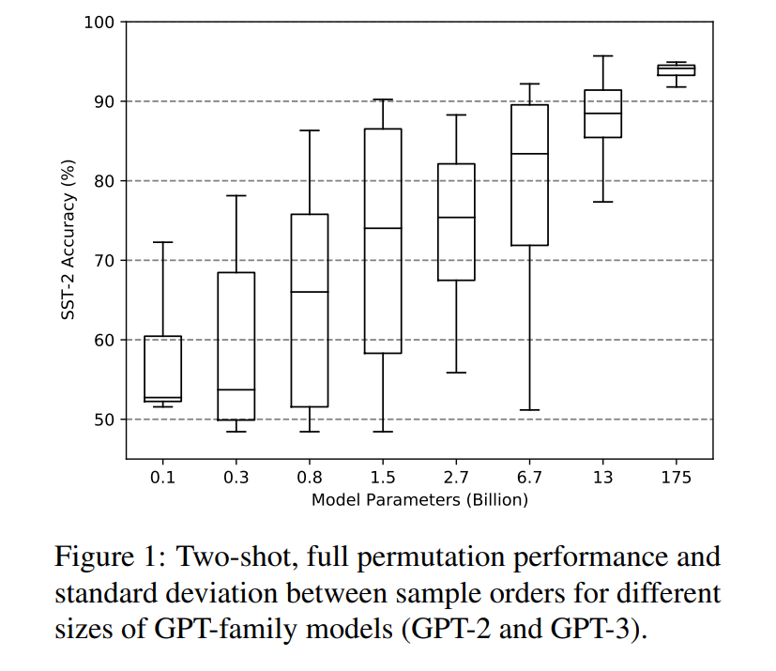
Sample ordering
1. no common denominators between performant sample orders and they are not transferable across different model sizes and tasks.
2. In a few-shot setting where the size of the development set is very limited, we can’t use dev set to select the best order.
Notes:
It shows the order influences the performance a lot. Though increase the model size can alleviate this problem( but it’s impractical)
There are other two problems for sample ordering
So how to select the sample order?

Slide 24
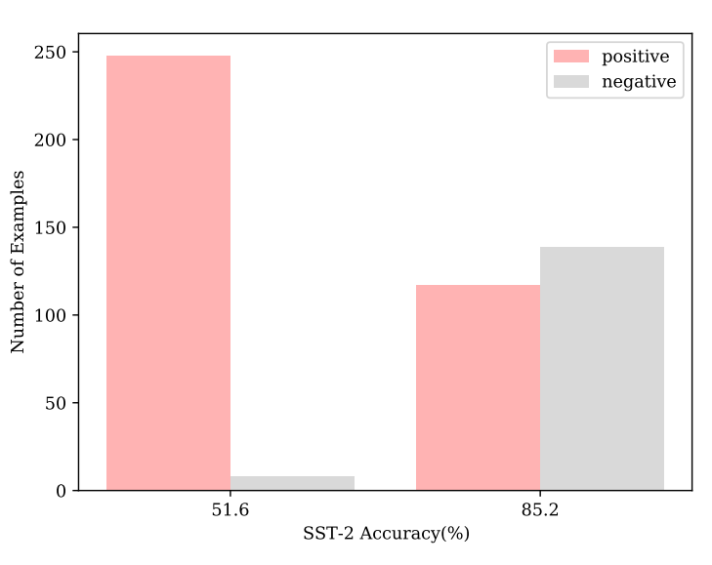
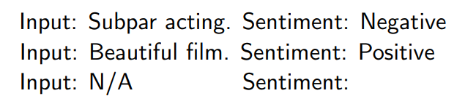

Sample ordering
ICML 2021 : Calibrate Before Use: Improving Few-Shot Performance of Language Models, Tony Z. Zhao
Any non-sentimental sentence
Positive: 50%
Negative: 50%
Calibrated:
GPT2-XL(1.5B)
Notes:
First let’s see a work in ICML 2021
If this is a good prompt
Here N/A can be replaced by any other non-sentiment sentences
So we can construct a training data set based on this idea
Refine the probability of GPT2 by a transformation layer, parameters w and b can be trained by the data we construct

Slide 25
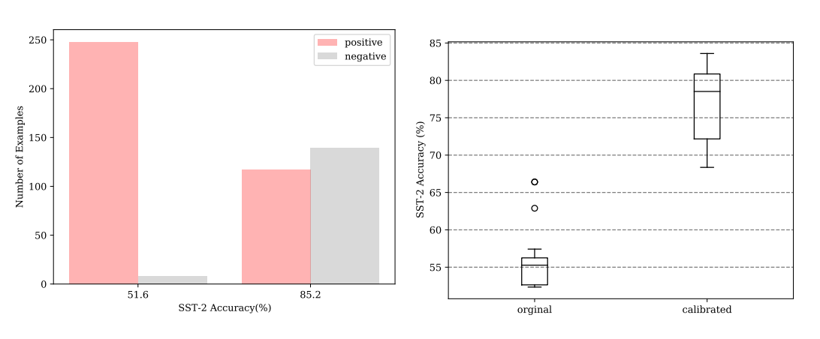
Sample ordering
Fantastically Ordered Prompts and Where to Find Them: Overcoming Few-Shot Prompt Order Sensitivity, Yao Lu
Notes:
In this work the author focus on sample ordering
They found calibrated didn’t solve sample order problem
Back to the last slide
So we need to choose which one is the best order
But the idea to create a training dataset can be used to create a probing dev set to rank all ordering permutations

Slide 26
Sample ordering
Fantastically Ordered Prompts and Where to Find Them: Overcoming Few-Shot Prompt Order Sensitivity, Yao Lu
Idea: Generate a ‘probing set’ to find performant prompt orderings
(i) for a randomly-selected set of training samples, we use every possible ordering permutation of this set as candidates
(ii) constructing a probing set by querying the language model using all candidate prompts as context
(iii) using this probing set to identify the best ordering by ranking them using a probing metrics.

Slide 27
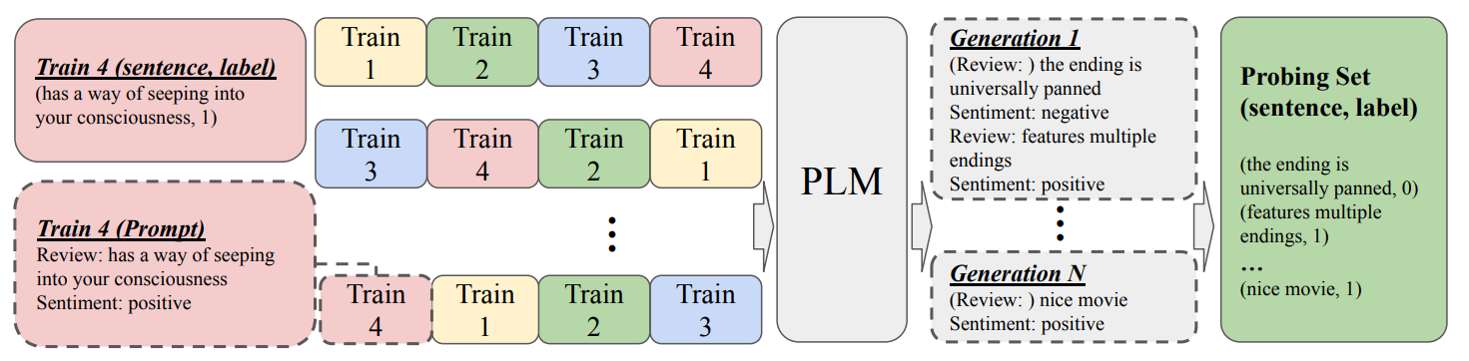
Construct probing set
Randomly sample 4 samples from the training set and get the prompt

Slide 28
Construct probing set
C1
C24
Get all the 24 different permutation as the candidate ordering

Slide 29
Construct probing set
(GPT2/GPT3)
Use a gpt2 or gpt3 model to generate a new sample based on the demonstration

Slide 30
Construct probing set
The same distribution
(GPT2/GPT3)
Convert the prompt back to original data format. Get the probing set.
Drop the generated labels.
The prob sentences in probing set should have the same distribution as training data (50%-50%)

Slide 31


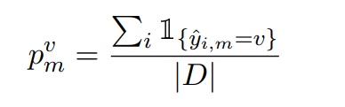
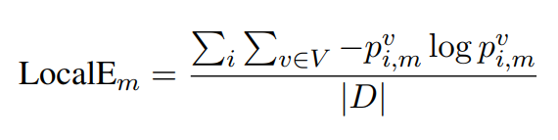
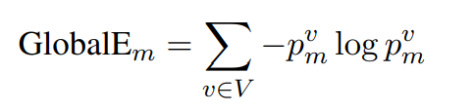
Evaluate ordering permutations
Global entropy
Local entropy
Choose the top 4 ordering permutation with max entropy
Notes:
If the ordering permutation lead to uniform distribution, the entropy should be the largest

Slide 32
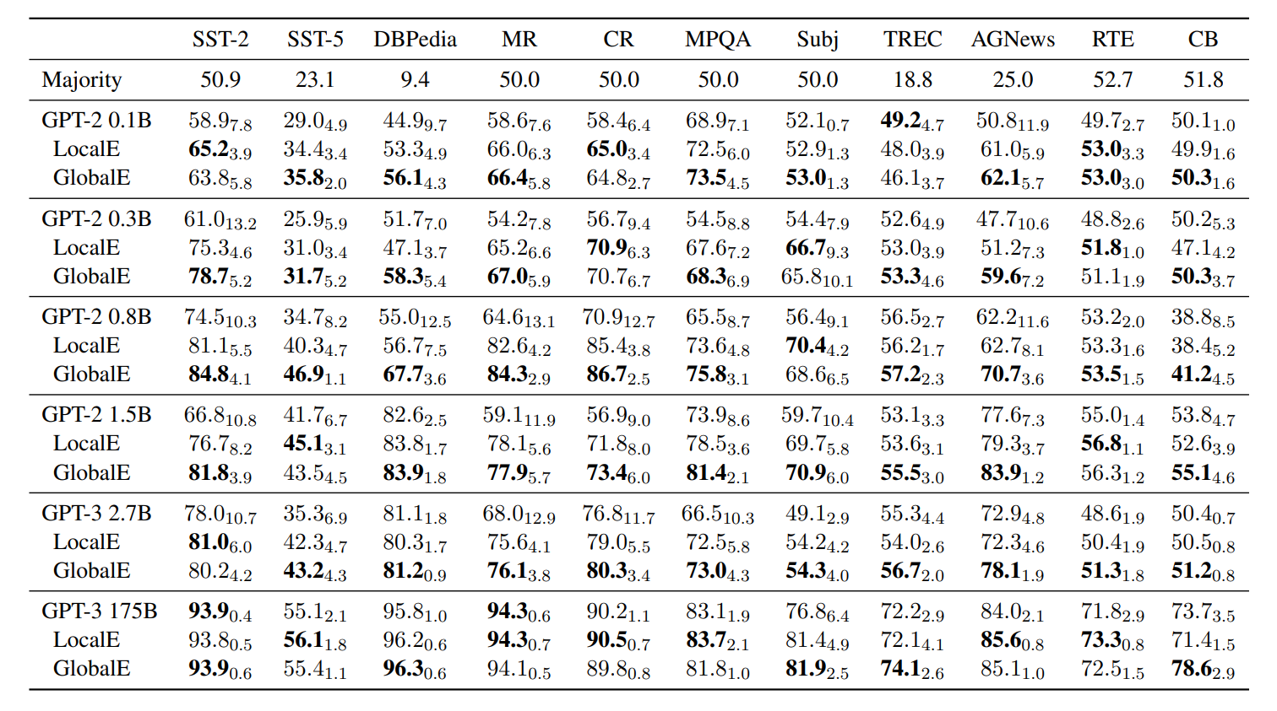
Results
Notes:
If the ordering permutation lead to uniform distribution, the entropy should be the largest

Slide 33
Context
What is demonstration
Two research directions of demonstration
Sample selection
Sample ordering
Conclusion

Slide 34
Conclusion
Demonstration is useful in few-shot learning
There are two main challenge in demonstration learning: which to sample and the ordering
There are still a lot of work can be done for these problems. Such as a end to end retriever

Slide 35
Thanks

